Slide 1

Pioneering Ideas in Management
Chathuranga Adhikari
B.com (Sp)(Hons), M.com

Slide 2

Lecture Outline
At the end of the lesson, you will be able to define;
Early Management Ideas
Classical Theorists
Behavioural Theorists
Quantitative Approach
Contemporary Ideas
Innovation & Management Theory

Slide 3

Why History and Theory?

Slide 4

Evolution
Management practice is as old as human civilization when people started living together in groups.
Every human group requires management, and the history of human beings is full of organizational and behavioral activities because human beings are the ‘social animal’.
However, the study of human managers is predominantly a twentieth-century phenomenon.

Slide 5
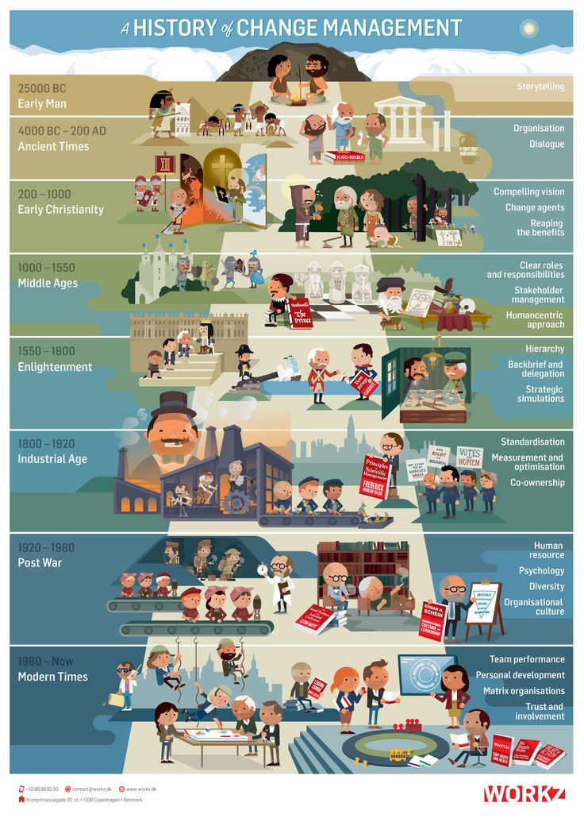
Early Management Ideas
The history of Management

Slide 6
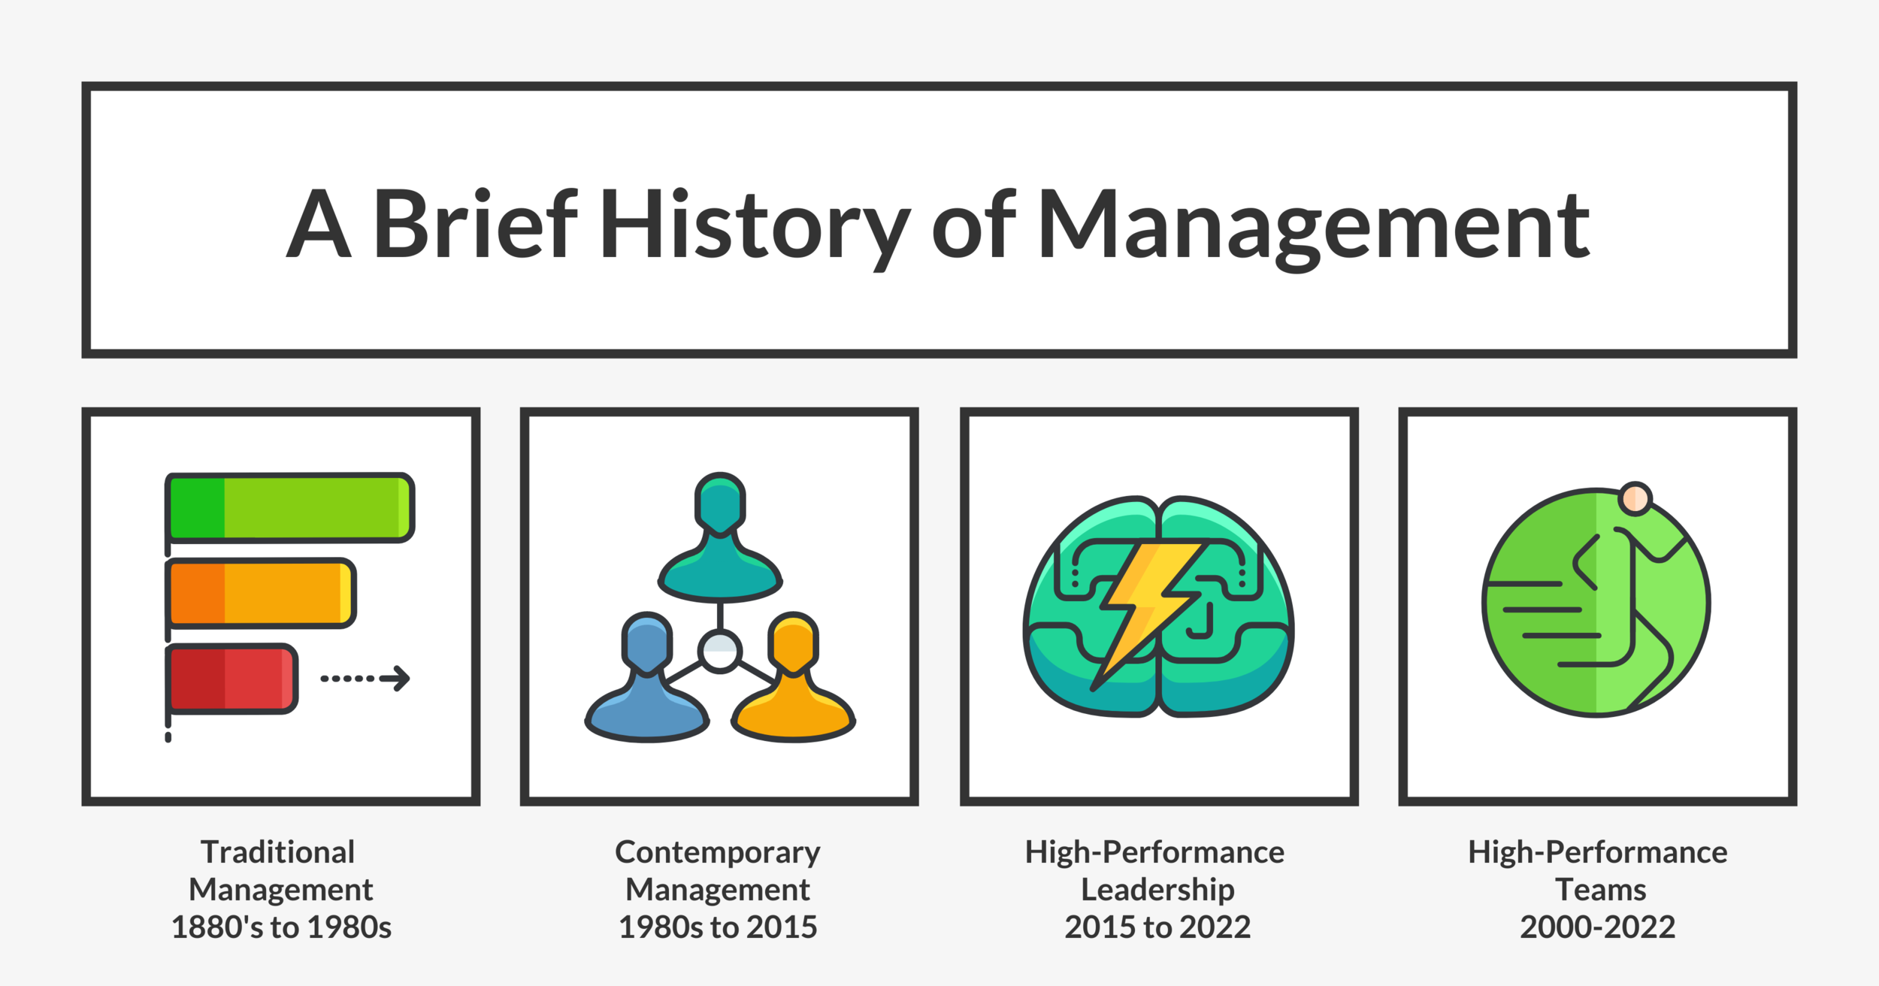
Early Management Ideas
The history of Management..

Slide 7
Early Management Ideas
Robert Owen (1771–1858)
Identified the importance of working and social conditions for employees.
Charles Babbage (1792–1871)
Ideas on work specialization, production efficiency, incentive, and profit-sharing plans.
Henry R. Towne (1844–1924)
Called for a ‘management science’ that would establish ‘principles’ of management.

Slide 8
Early Management Ideas
Assessing the early contributions:
Uncoordinated efforts.
Contributions tended to relate to specific problems.
Did not see ‘management’ as a separate field or skill (until Towne).

Slide 9
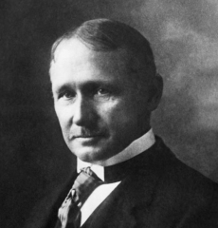
Early Management Ideas
“Management is the art of knowing what you want to do and then seeing that they do it in the best and the cheapest manner.”
F.W. TAYLOR

Slide 10
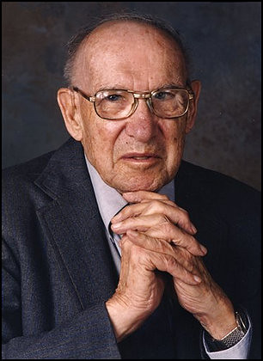
Early Management Ideas
“Management is a multipurpose organ that manages a business and manages managers and manages workers and work.”
PETER DRUCKER

Slide 11
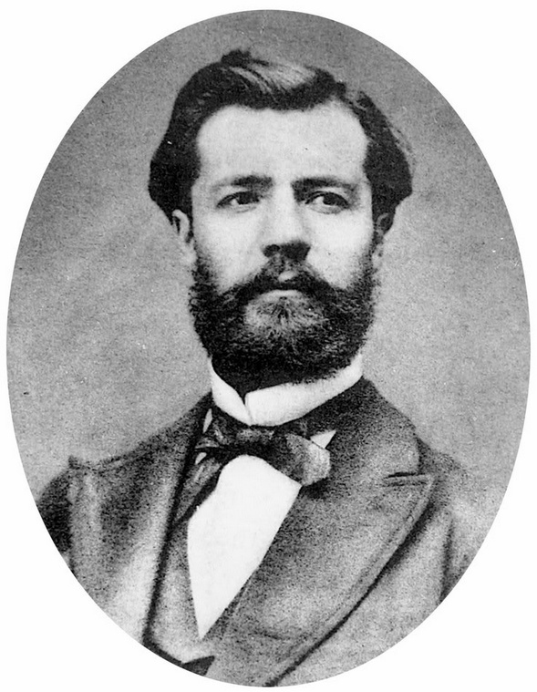
Early Management Ideas
“Management is to forecast, to plan, to organize, to command, to coordinate and control activities of others.”
HENRY FAYOL

Slide 12
Classical Theorists
This viewpoint emphasizes efficiently managing work and organizations.
It comprises three different management approaches:
Scientific - F. W. Taylor, F. & L. Gilbreth, H. Gantt
Administrative - H. Fayol, C. Barnard
Bureaucratic - M. Weber

Slide 13
1. Scientific Approach
“Scientific management is an approach in classical management theory focusing on the scientific study of work methods to improve worker efficiency.”
Frederick W. Taylor
Concerned with improving the performance of individual workers.
Practiced in early 20th Century.
Business was expanding and capital was readily available, but labour was in short supply.

Slide 14
1. Scientific Approach
Four principles of scientific management
Select and train the best.
Determine the most efficient work methods.
Co-operate with workers to ensure the best method is used.
Divide work/responsibility between workers and managers.
Frank & Lillian Gilbreth
Time and motion studies
Human implications of Scientific Management
Henry Gantt
Pay incentives
Gantt chart

Slide 15
Objectives of the Scientific Approach
Quality control
Incentive wages
Higher productivity
Cost reduction
Right Men for the Right Job
Elimination of wastage

Slide 16
2. Administrative Approach
“The approach focused on principles for managers to coordinate organizations’ internal activities.”
Focus on Managing the total organization.
Contributed more to later development in Management Theory.

Slide 17
2. Administrative Approach
Henri Fayol’s Principles of Management
Division of work
Authority
Discipline
Unity of command/direction
The primacy of general interest
Remuneration
Esprit de corps (Loyalty)
Centralization
Scalar chain
Order
Equity
Low turnover
Initiative

Slide 18
2. Administrative Approach
Organising
Planning
Commanding
Henri Fayol
Controlling
C
o-ordinating

Slide 19
Objectives of the Administrative Approach
Enhance Efficiency
Promote effective Human Resource Management
Clearly define Rules, Responsibilities, and Functions.

Slide 20
3. Bureaucratic Approach
“An Approach which “saw an organization's need to operate rationally rather than relying on the arbitrary whims of owners and managers.”
Weber’s Ideal Bureaucracy
Specialization of labour
Formal rules & procedures
Impersonality
Well-defined hierarchy
Advancement on merit

Slide 21
3. Bureaucratic Approach
Hierarchy
Advancement
of
on merit
positions
Specialisation
Max Weber
of labour
Formal rules & procedures

Slide 22
THE CLASSICAL APPROACHES TO MANAGEMENT
Scientific Management
Bureaucratic Management
Administrative Management
Focuses on the individual worker’s productivity
Focuses on the overall organizational system
Focuses on the functions of management

Slide 23
Contributions
Laid the foundation for later developments in management theory.
Identified important management processes, functions, and skills that are still recognized.
Focused attention on management as a valid subject of scientific inquiry.

Slide 24
Limitations
More appropriate for stable and simple organizations.
Many viewed employees as tools rather than resources.
Prescribed universal procedures that are not appropriate in some settings.

Slide 25
Behavioural Theorists
Perspective on management emphasizes “the need to understand the effect of different factors on human behaviour in organizations.”
Emphasizes individual attitudes and behaviors and group processes.
Necessity of understanding the role of behavior in organizations

Slide 26
Behavioural Theorists
Early Theorists:
Hugo Munsterberg
“Psychology and Industrial Efficiency” Creating optimal psychological conditions, behaviour shaping
Mary Parker Follett Importance of group functioning
Hawthorne studies Importance of supervisory style
Focused on behavior in the workplace

Slide 27
Behavioural Theorists
Human relations movement
Abraham Maslow Hierarchy of needs
Douglas McGregor Theory X & Y

Slide 28
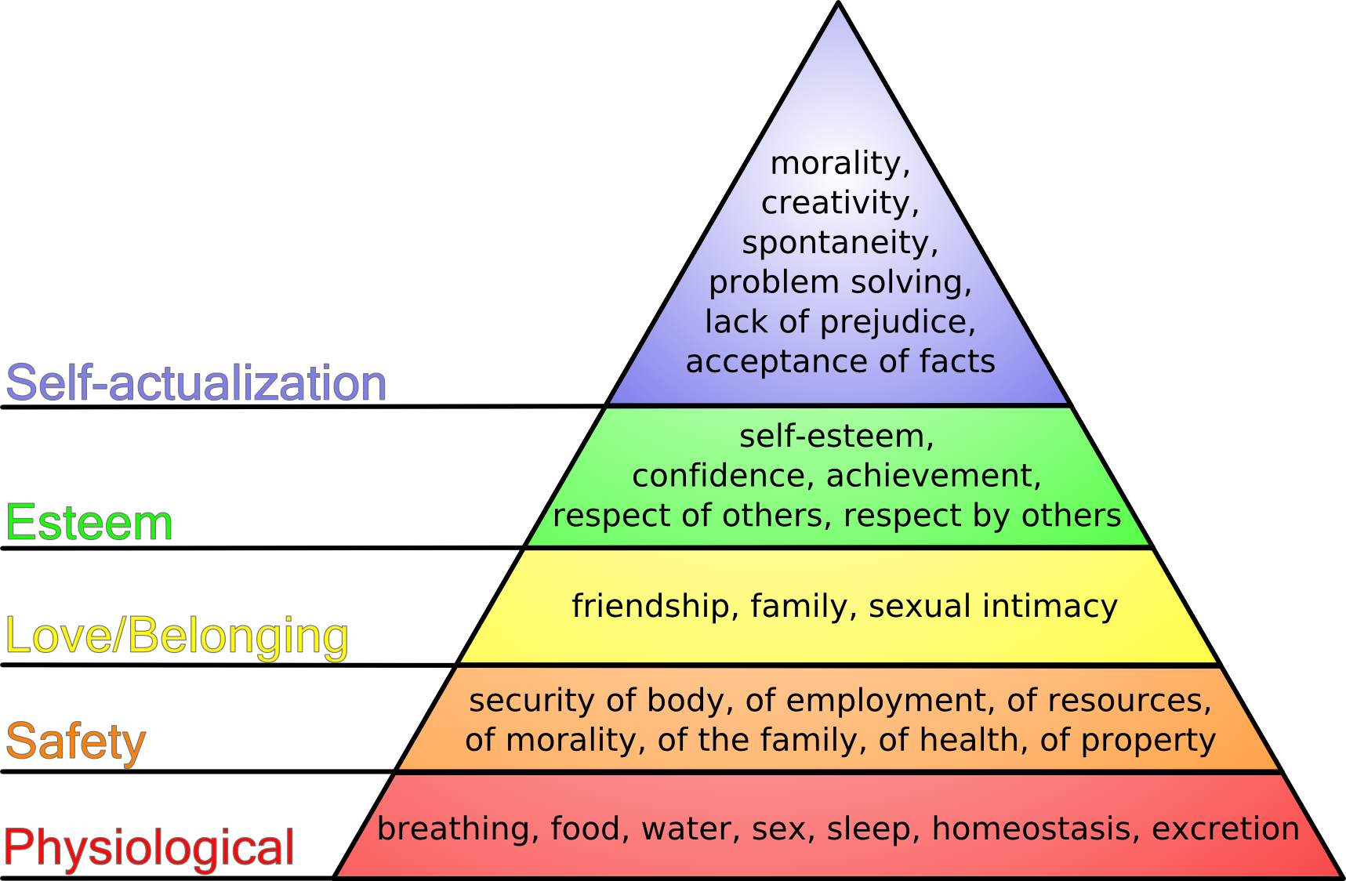
Behavioural Theorists
MASLOW’S HIERARCHY OF NEEDS

Slide 29
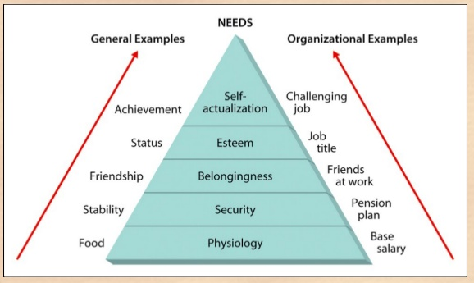
MASLOW’S HIERARCHY OF NEEDS
General & Organizational Examples

Slide 30
Physiological needs. Maslow grouped all physical needs necessary for maintaining basic human well‐being, such as food and drink, into this category. After the need is satisfied, however, it is no longer a motivator.
Safety needs. These needs include the need for basic security, stability, protection, and freedom from fear. A normal state exists for an individual to have all these needs generally satisfied. Otherwise, they become primary motivators.
Belonging and love needs. After the physical and safety needs are satisfied and are no longer motivators, the need for belonging and love emerges as a primary motivator. The individual strives to establish meaningful relationships with significant others.
Esteem needs. An individual must develop self‐confidence and want to achieve status, reputation, fame, and glory.
Self‐actualization needs. Assuming that all the previous needs in the hierarchy are satisfied, an individual feels a need to find himself.
Maslow's hierarchy of needs theory helped managers visualize employee motivation.

Slide 31
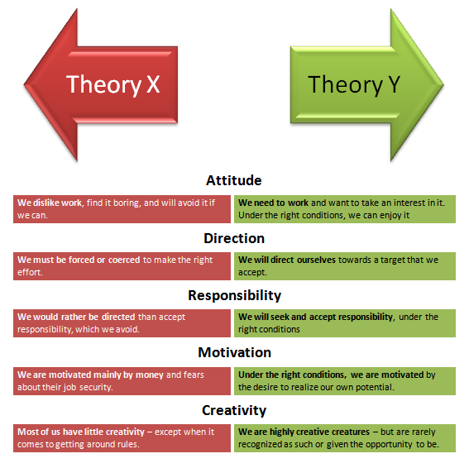
Behavioural Theorists
McGREGOR’S THEORY X & Y

Slide 32


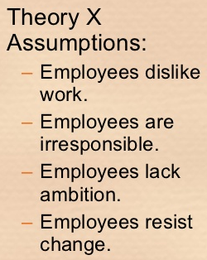
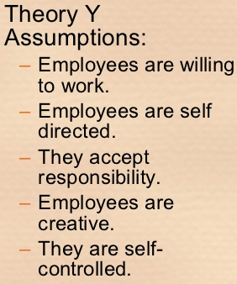
McGREGOR’S THEORY X & Y
Scientific
Behavioral

Slide 33
Contributions
Provided important insights into motivation, group dynamics, and other interpersonal processors in organizations
Focused managerial attention on these processes.
Challenged the view that employees are tools and furthered the belief that employees are valuable resources.

Slide 34
Limitations
The complexity of individual behavior makes prediction of that behavior difficult.
Many behavioral concepts have not yet been put to use because some managers are reluctant to adopt them.

Slide 35

Qunatitative Approach
Focused on mathematics, statistics and information aids supporting managerial decision making and organisational effectiveness.
Developed during World War II. (1940 to present)

Slide 36
Quantitative Management Viewpoint
Management Science
The approach aimed at increasing decision effectiveness through the use of sophisticated mathematical models and statistical methods.’
Operations management
Function or field of expertise primarily responsible for managing production and delivery of an organization’s products and services.’
Management information systems
Field of management focused on designing and implementing computer-based information systems for use by management.’

Slide 37
Contributions
Developed quantitative techniques to assist in decision making.
Increases awareness and understanding of complex organizational processes and situations.
Very useful in planning and controlling.

Slide 38
Limitations
Cannot fully explain or predict the behavior of people in organizations.
Mathematical sophistication may come at the expense of other important skills.
Models may require unrealistic or unfounded assumptions.

Slide 39
Contemporary Ideas
Systems Theory
The approach is based on the idea that organizations can be visualized as systems.
Contingency Theory
Viewpoint argues that appropriate managerial action depends on the particular parameters of the situation.
Theory Z
Concept combining positive aspects of American and Japanese management into a modified approach aimed at increasing managerial effectiveness while remaining compatible with the norms and values of American society and culture.
Total Quality Management (TQM)
Approach highlighting collective responsibility for product and service quality and encouraging individuals to work together to improve quality.

Slide 40

Innovation & Management Theory
PROMOTING INNOVATION
Each management viewpoint provides a contribution to managing innovation:
Classical
Behavioural
Quantitative
Contemporary

Slide 41
Lecture Summary
Early Management Ideas
Generation of ideas leading to the identification of management as a significant field of inquiry.
Classical Theorists
Emphasized finding ways to more efficiently manage work and organizations.
Behavioural Theorists
Emphasized the importance of trying to understand factors affecting human behavior in organizations.

Slide 42
Lecture Summary
Quantitative Approach
Focuses on mathematics, statistics, and information aids supporting managerial decision-making and effectiveness.
Contemporary Ideas
Views of organizations as systems, the importance of contingency factors & amalgamating Japanese & American management practices.
Innovation & Management Theory
Each approach provides insights, knowledge & practice regarding the management of innovation in organizations.

Slide 43
Thank you

